Slide 1
RefreshCache v3
Remember Why You’re Here
Nick Airdo
Community Developer Advocate
Central Christian Church AZ (cccev)
Nick.Airdo@CentralAZ.com
@airdo

Slide 2
Pray
Will you join me in a prayer?

Slide 3
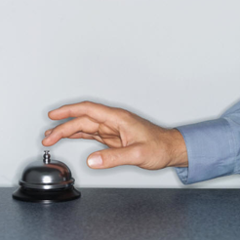
Notes:
Started when we realized it was much more effective to stop asking the vendor to do something -- and just do it ourselves.

Slide 4

WE MUST BE THE CHANGE
…we wish to see in the world.
- Ghandi
Notes:
There is only one way to invoke change – and that’s to start with yourself.

Slide 5
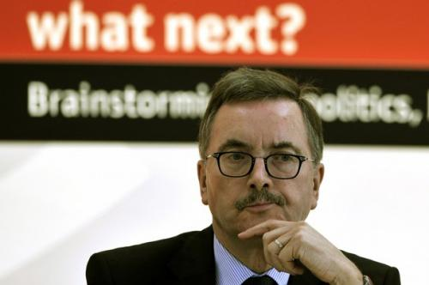
Notes:
What do we need next?

Slide 6
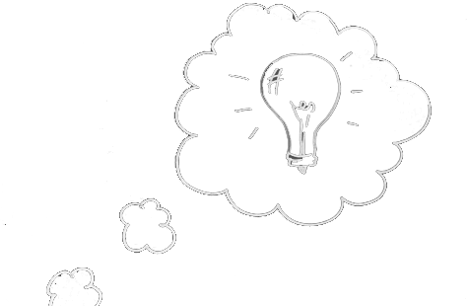
Notes:
Most of you already know what you want.

Slide 7
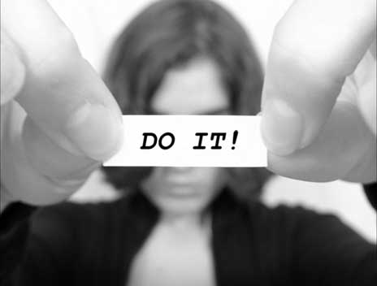
Notes:
No one is going to help you get it done – so if you really want it done -- you’ve got to do it yourself.
At least get it started and perhaps others will join you.

Slide 8
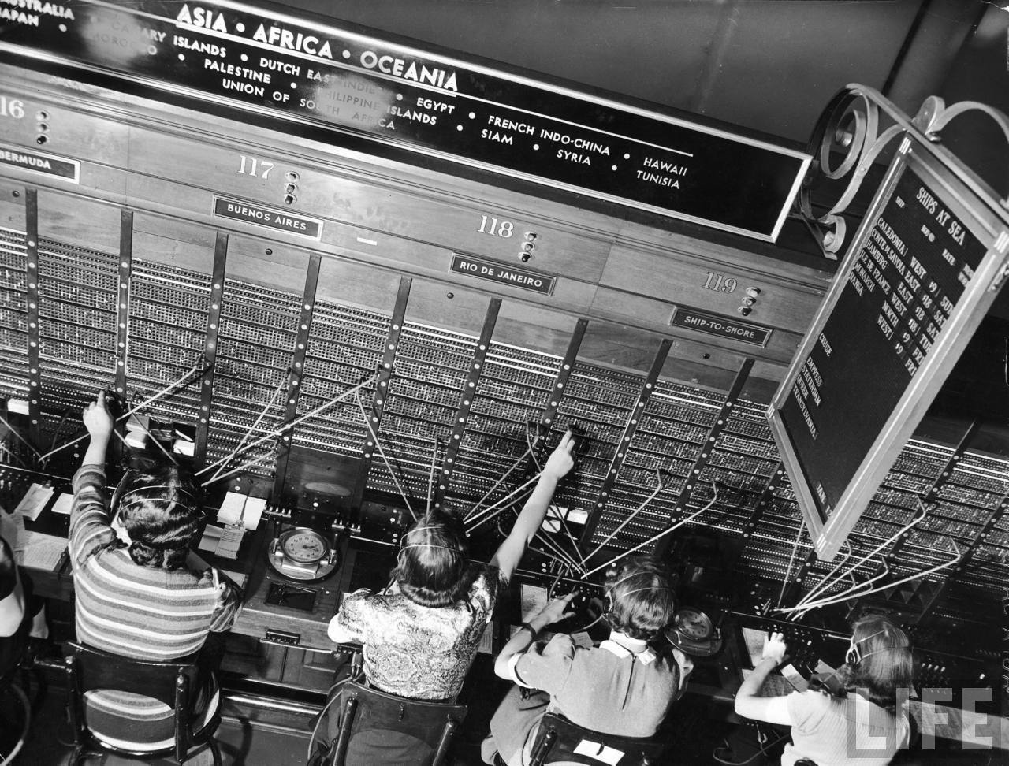
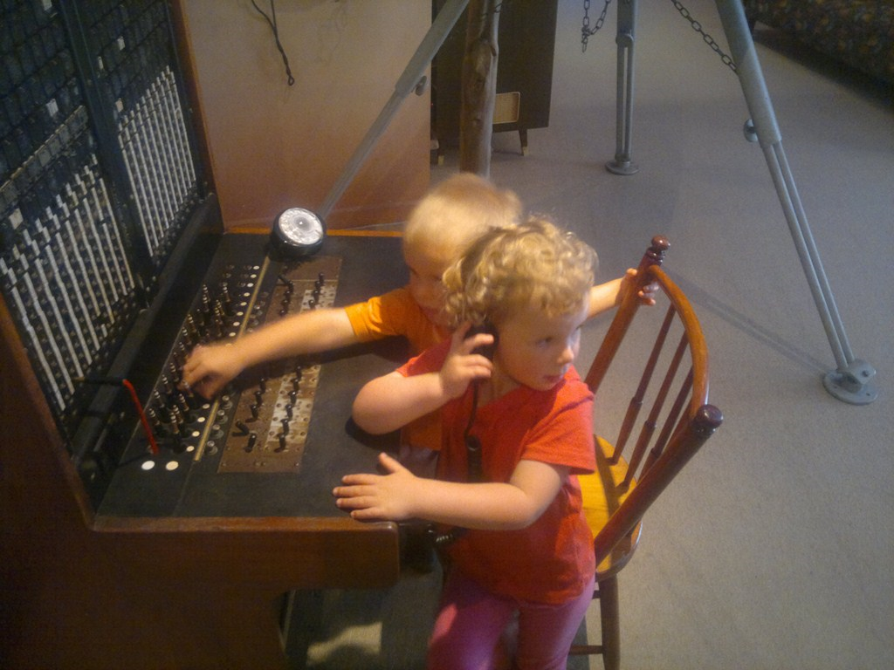
Notes:
We’re here to help you learn. We’re here to help you take action.

Slide 9
IRC - #ArenaChMS
community.arenachms.com

Slide 10
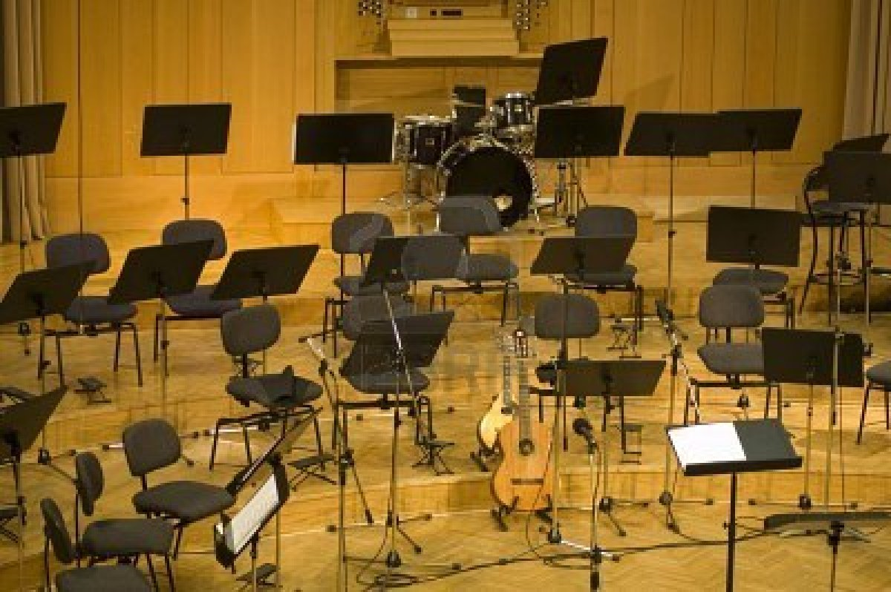
Notes:
Do you see disparity, problems, etc. or do you see hope and opportunity?

Slide 11

Notes:
You cannot succeed until you see the possibility – until you see yourself in your role in the solution.

Slide 12
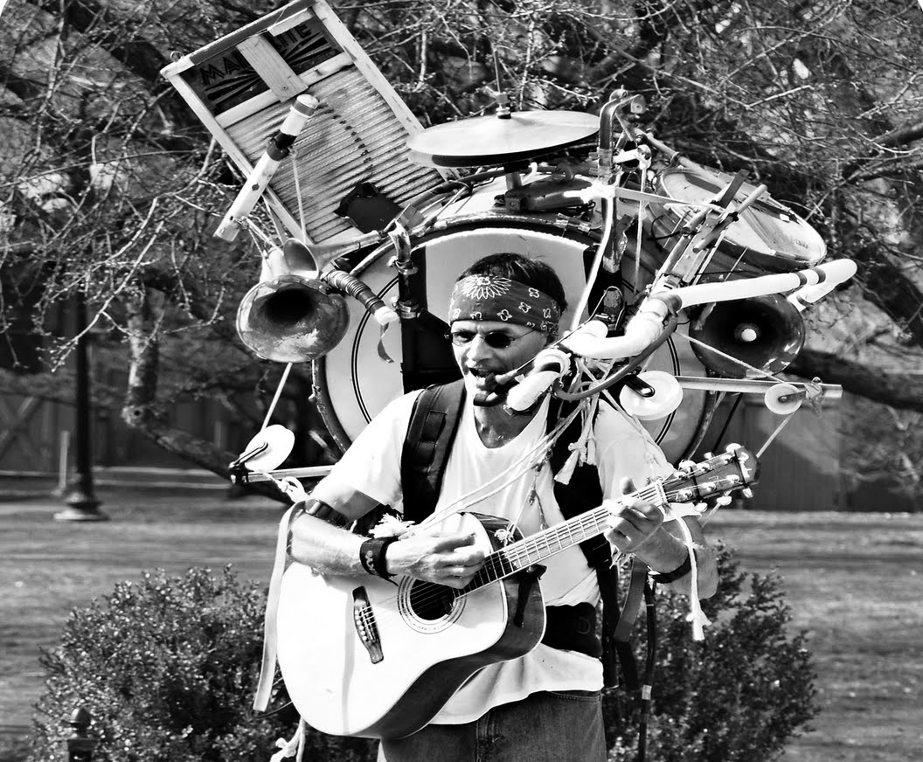
Notes:
You are the solution.

Slide 13
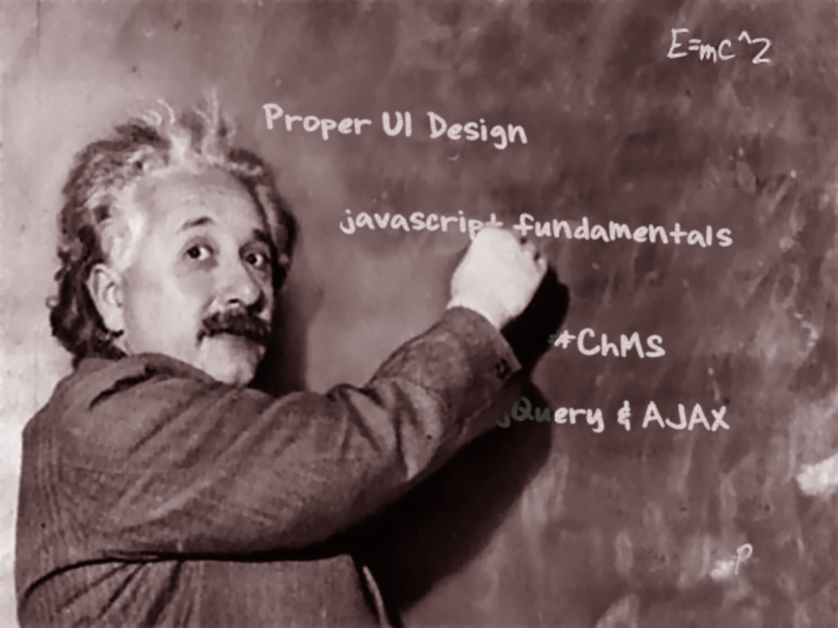
Notes:
You’re going to hear from people outside our domain and outside our system (Arena). Take advantage of this and learn from them.

Slide 14
‘You were created in the image of God! What are you waiting for?!!! The moment you met Jesus something came alive in you. The Church needs to reclaim the epicenter of creativity for the human race. We used to be the best poets, scientists.’
- Erwin McManus

